Slide 1
Bombastic Bookstore
Team Members: Brandon Biggs, Joshua Macy, Julia McDonald, Ryan Burres, James Dove, and Jaylan Chavis
Date: November 24th, 2024

Slide 2

Introduction
Local Server built on Django and SQL for Managing Books
Purpose and objectives
Importance and relevance

Slide 3
Overview
High-level description of the software
Target Audience
- Bookworms
- Bookstore Owners
Scope and features
- Database Manipulation
- Theme Customization

Slide 4


Development Process
Agile Methodology
- Sprint 1 Setting Up the Backend
- Sprint 2 Barebones Front End
- Sprint 3 Finishing the Backend
- Sprint 4 Finishing Front End
- Sprint 5 Overall Polish
Challenges: Scheduling Conflicts solved by changing meeting times

Slide 5
Architecture and Design
Overview of software architecture
Design principles and decisions
Diagrams or visuals to illustrate architecture

Slide 6
Key Features
Inventory Management
Adding, removing, editing, etc
Organization, Customization, Controlled User Access Levels
Screenshots or demos of key features

Slide 7

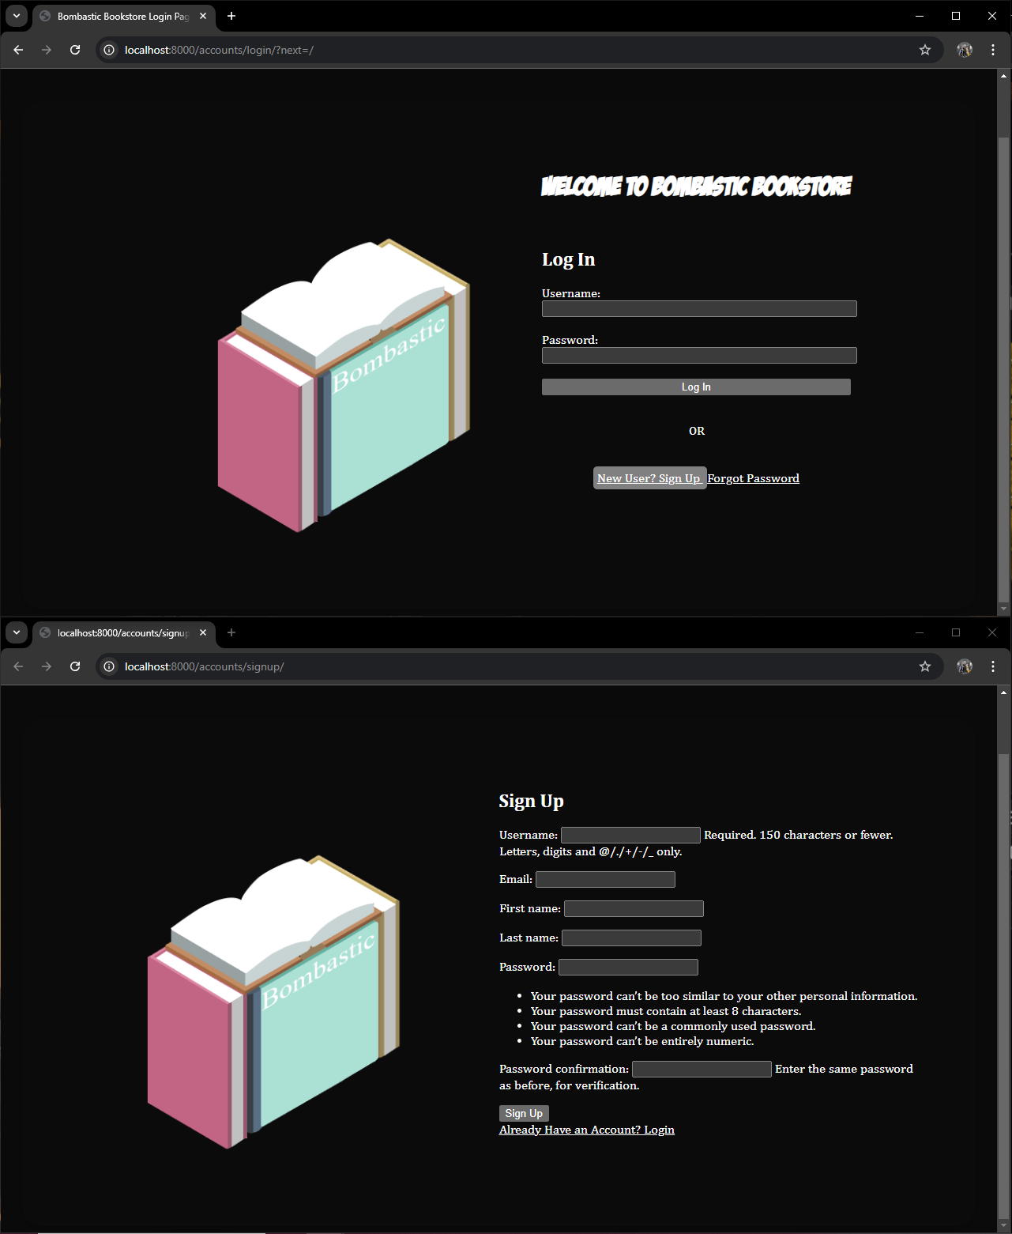

Login and Sign-Up for Multiple User capability

Slide 8
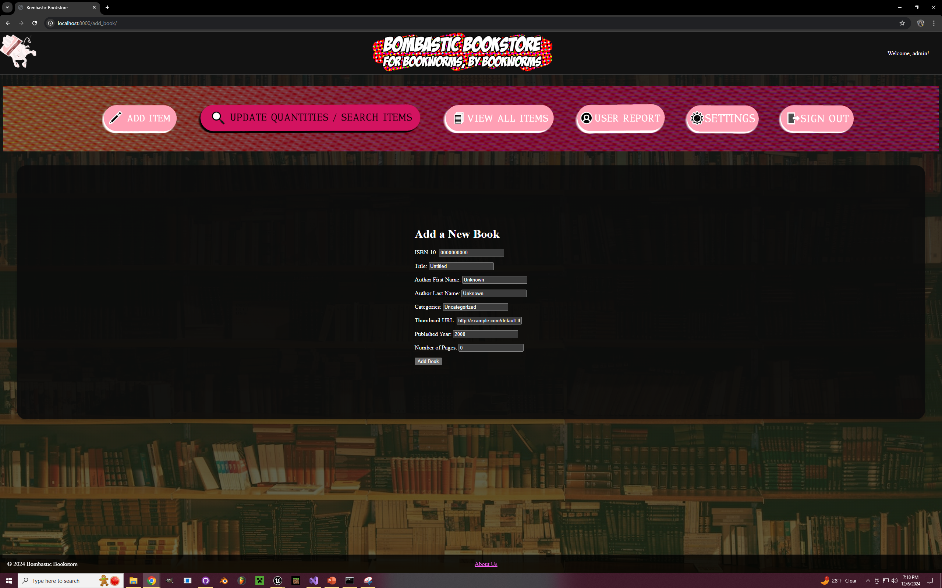
Add Books
Fill out the necessary categories.
The “Add Book” button then submits the information to the database.

Slide 9
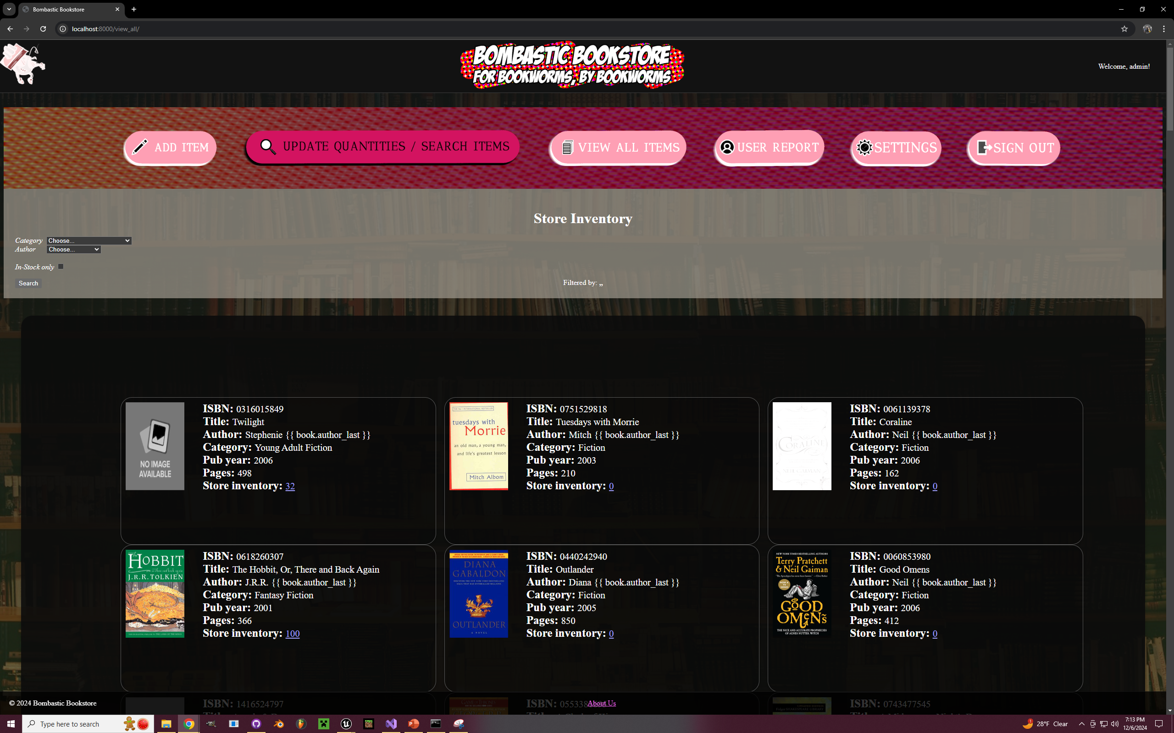
View All Page
Easy Access to full database inventory
Filter Capability

Slide 10
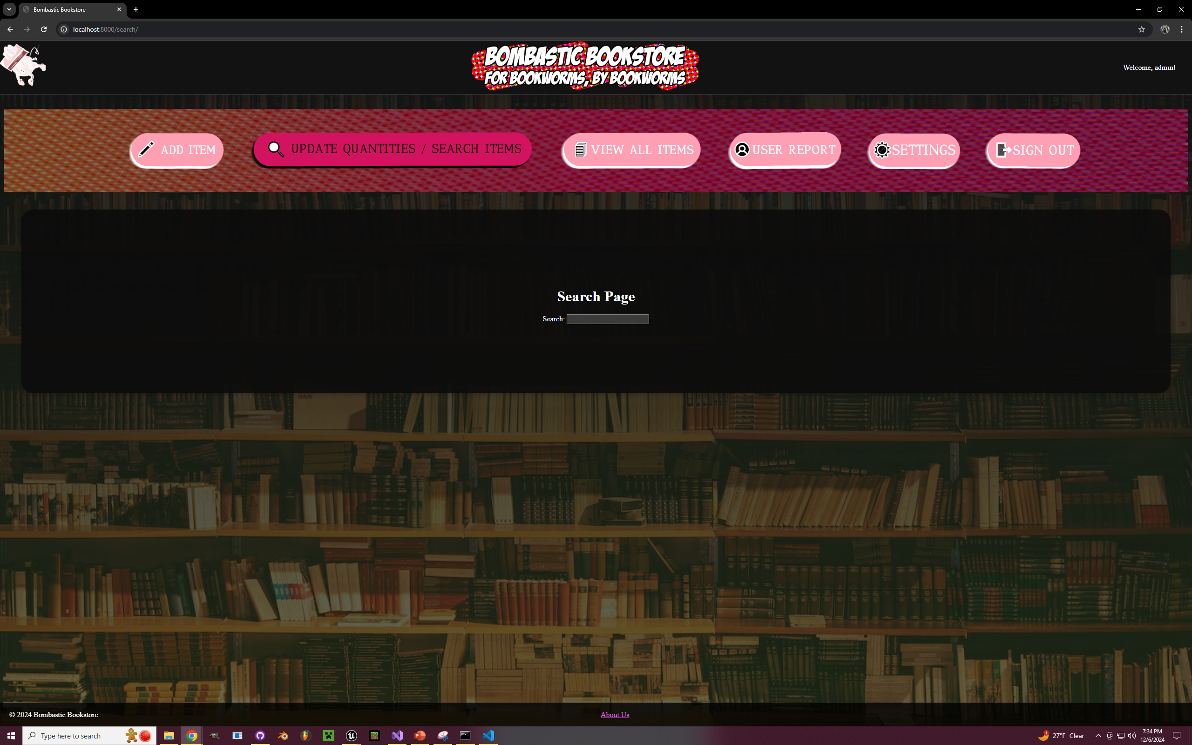
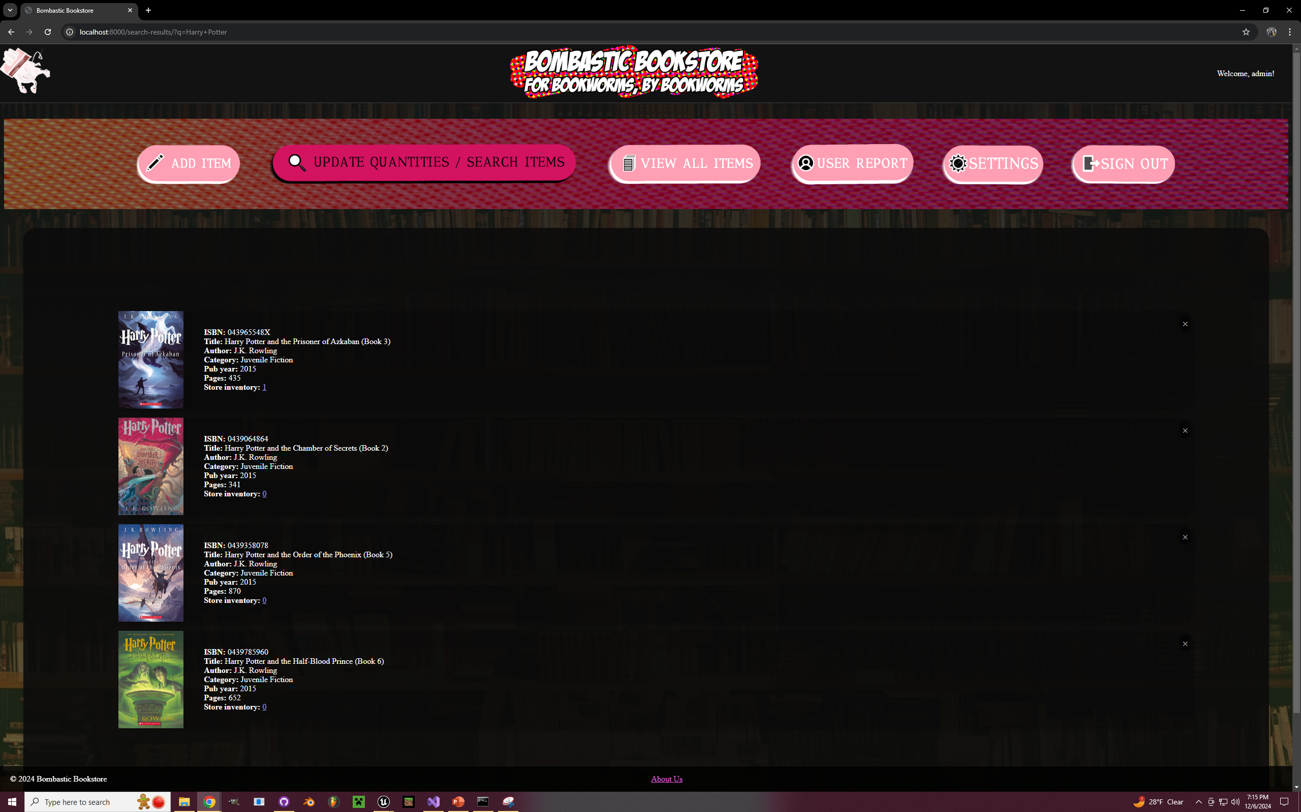
Search Results
Find books quickly
Click the X for Book Removal Confirmation

Slide 11
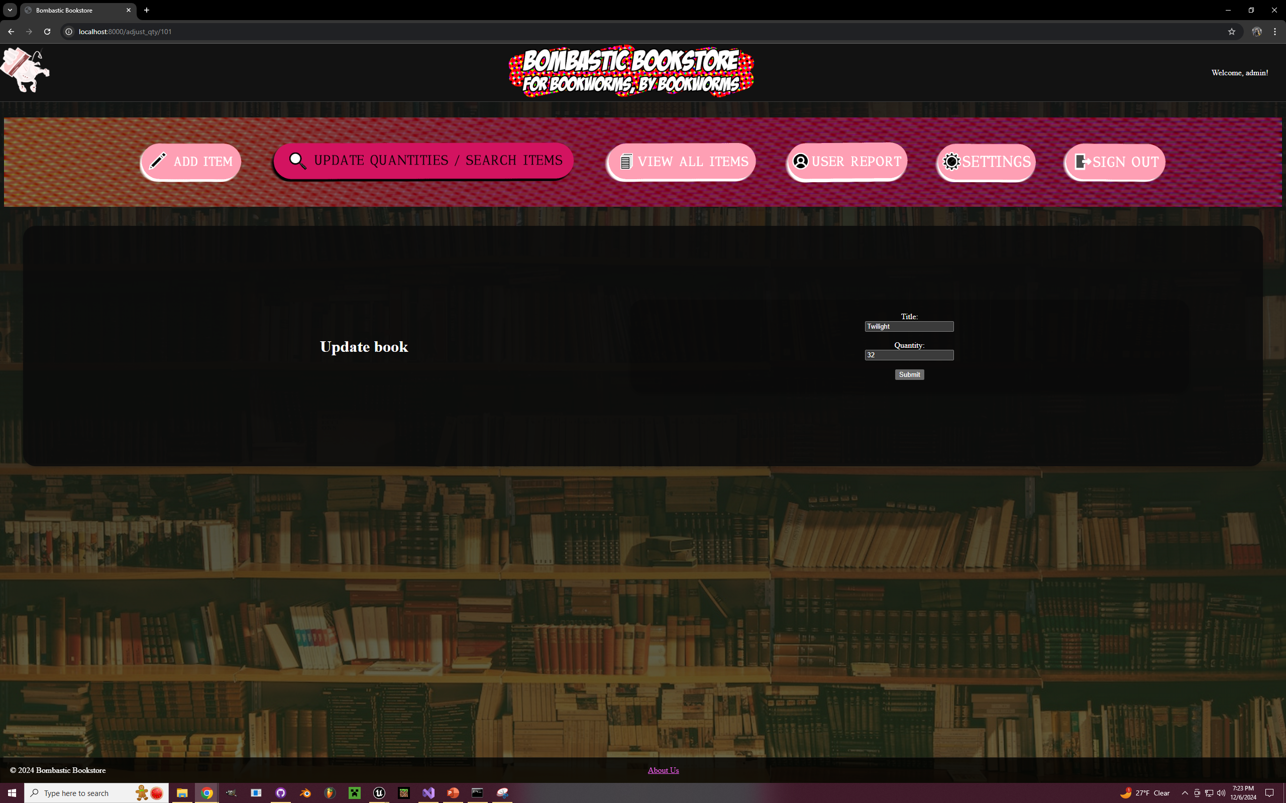
Update Quantity Page
Dedicated Page for updating bookstore quantity per book.
Accessed from either Search Results or View All quantity amount clicked.

Slide 12
Development Highlights
Major Achievements and milestones
Notable development efforts or challenges
- Setting up a server
- Manipulating a SQL Database
- CSS Themes

Slide 13
Testing and Quality Assurance
Manual Testing
Checked Input validation
Visual Bugs
Github Pull Request/Review Process

Slide 14
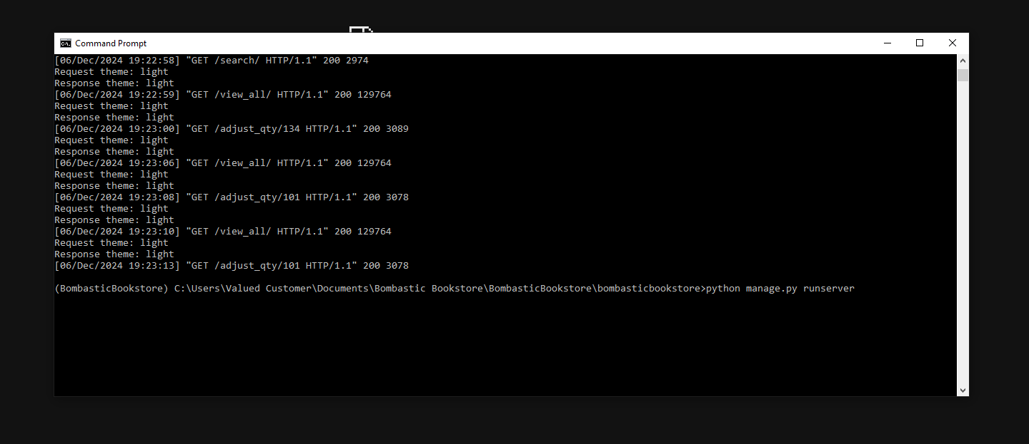
Deployment
Requires manual deployment after installation.

Slide 15
User Feedback
Website was ugly.
Login Page did mesh well with main page.
Improved aesthetics as a result.
Login Page conformed and simplified.

Slide 16
Future Plans
Comic book-like aesthetic
Deployment to Google Cloud
Online Storefront/Shopping feature

Slide 17
Conclusion
Recap of key points covered in presentation
Thank you
Contact information:
Jaylan Chavis: jmchavis3@my.waketech.edu
Ryan Burres: rsburres@my.waketech.edu
Brandon Biggs: bmbiggs@my.waketech.edu
James Dove: jedove@my.waketech.edu
Joshua Macy: jmacy@my.waketech.edu
Julia McDonald: jfmcdonald@my.waketech.edu

Slide 18
Questions

